Slide 1


CREDIT CARD DEFAULT RISK ANALYSIS
Insights and Predictions from Data

Slide 2



INTRO
Credit Card Market Overview: The global credit card market is vast and continues to grow, driven by increasing consumer spending and digital transactions. However, this growth comes with the challenge of managing credit card defaults.
Default Issue: Credit card defaults pose significant risks to financial institutions, affecting their bottom line and stability. The ability to predict these defaults can significantly mitigate these risks.
Objective: The presentation aims to showcase the use of data analysis and predictive modeling to forecast default probabilities, enabling more informed decision-making to manage and mitigate credit card default risks.

Slide 3
PROBLEM STATEMENT
Bank's Challenge: Financial institutions face increasing pressures from rising default rates, which can lead to substantial financial losses and erode customer trust.
Financial Stability: Defaults impact not just immediate revenue but also long-term financial stability, necessitating higher provisions for bad debts and affecting overall market competitiveness.
Market Reputation: The reputation of a bank can be significantly tarnished by high default rates, leading to a loss of customer confidence and potential regulatory scrutiny.

Slide 4

DATA OVERVIEW
Dataset Description: The dataset includes 23 variables, such as demographic information, credit amount, payment history, and other relevant financial indicators, offering a comprehensive view of potential risk factors.
Importance: Analyzing this dataset allows for a deep understanding of the factors contributing to credit card defaults, facilitating the development of models to predict such events accurately.

Slide 5

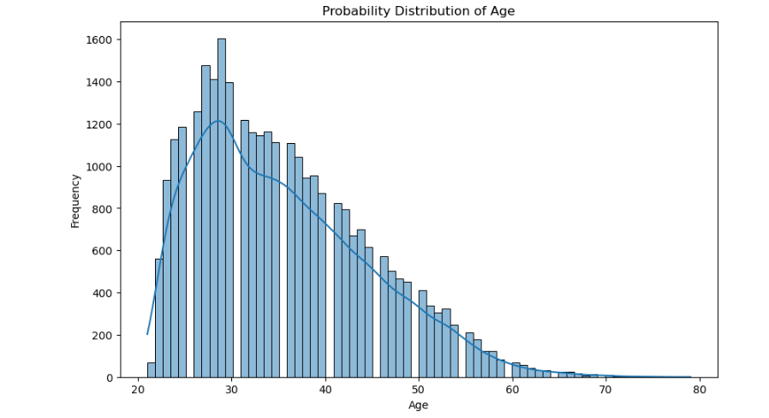
ANALYTICAL APPROACH
Data Cleaning and Preparation: Detail the initial steps of handling missing data, correcting anomalies, and normalizing data to prepare for analysis.
Exploratory Data Analysis (EDA): The process and tools used to explore data trends, distributions, and relationships between variables to form hypotheses.

Slide 6
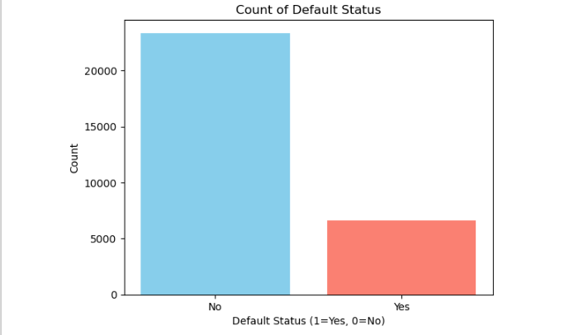
Hypothesis Testing: Outline the statistical tests performed to validate assumptions and hypotheses about the factors influencing credit card defaults.

Slide 7
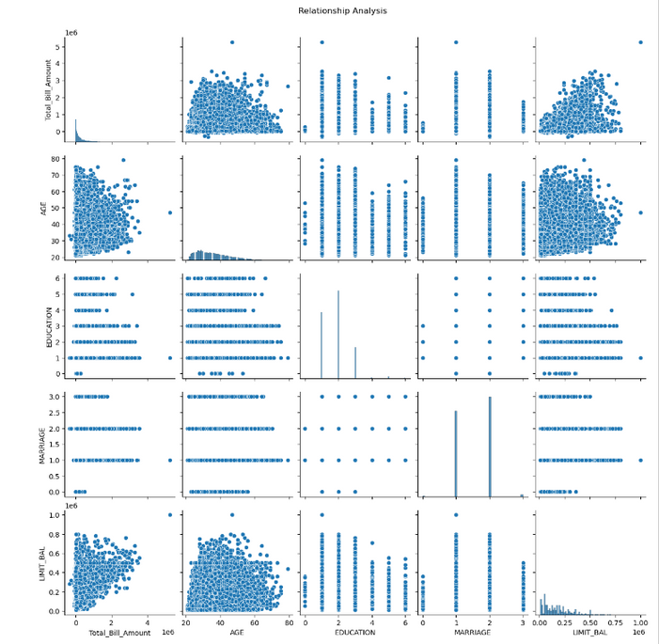
INSIGHTS FROM DATA VISUALIZATION
Trends and Patterns:
These Visuals demonstrate trends in credit usage and payment delays, highlighting seasonal variations and potential predictors of default.
Analysis of how these trends vary across demographic groups, providing insight into risk factors.
Demographic Correlations:
Charts and graphs showing the correlation between demographic factors (such as age and income) and default rates.
These insights help in identifying at-risk customer segments and tailoring risk mitigation strategies accordingly.

Slide 8
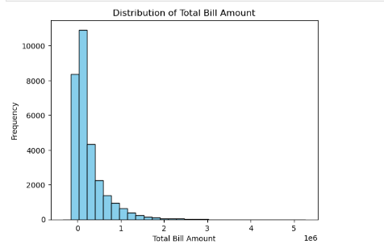
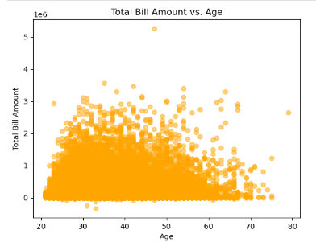
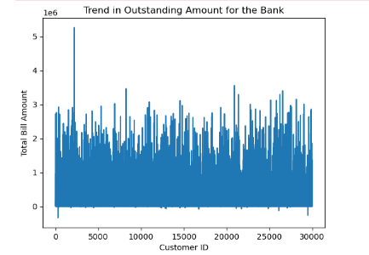
The first image displays a histogram highlighting that most bill amounts are low with a few high outliers. The second scatter plot shows a wide variation in bill amounts across different ages, without a noticeable pattern. Lastly, the line plot indicates erratic fluctuations in the outstanding amounts across customer IDs, no clear trend in the financial data.

Slide 9
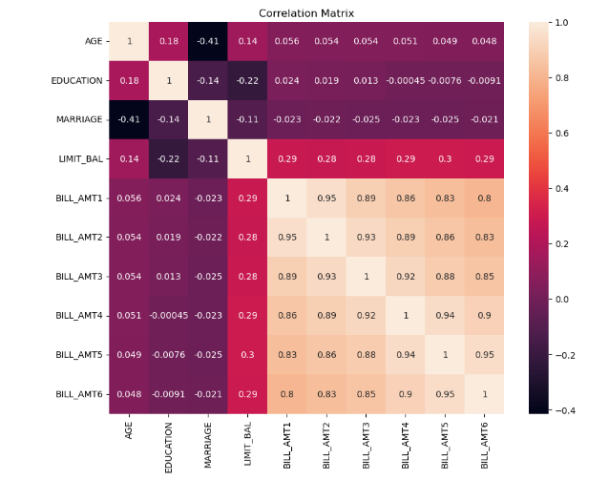
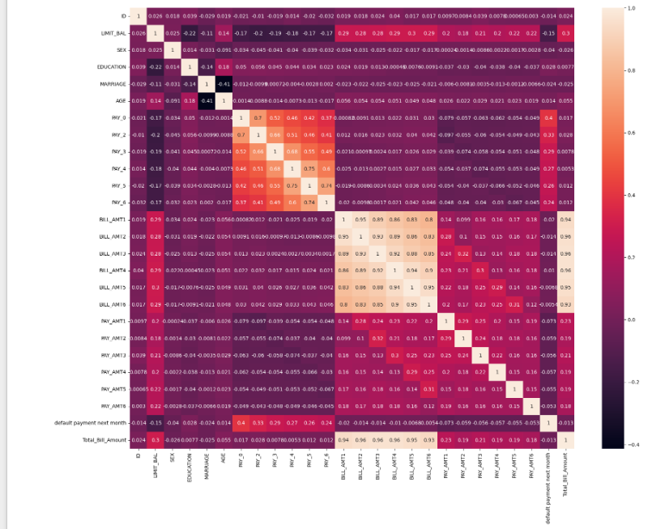
High positive correlations are evident between consecutive monthly bill amounts. Negative correlation between marriage and age. Moderate correlations between the credit limit, repayment status.

Slide 10

MODEL BUILDING
Models Tested:
Examined various predictive models, including Logistic Regression for its simplicity and interpretability, Random Forest for its ability to handle non-linear relationships, and XGBoost for its performance in handling diverse datasets.
Handling Imbalanced Data:
Discussed on the prevalence of imbalanced data in default prediction and strategies employed to address it, such as model class weights, oversampling, undersampling, and synthetic data generation.
Evaluation Metrics:
In-depth look at how models were evaluated using metrics like accuracy, precision, recall, F1-score, and AUC-ROC to assess their ability to predict defaults accurately and minimize false positives/negatives.

Slide 11
MODEL PERFORMANCE AND EVALUATION
Comparative Analysis:
Detailed comparison of model performances, backed by data visualizations, to illustrate which models performed best across different metrics.
Best Performing Model:
Focus on XGBoost, discussing its advantages in handling the dataset's complexity, its robustness to overfitting, and how it emerged as the most effective model for predicting defaults.

Slide 12
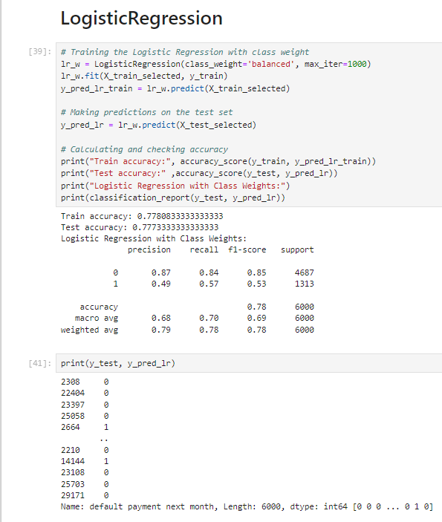
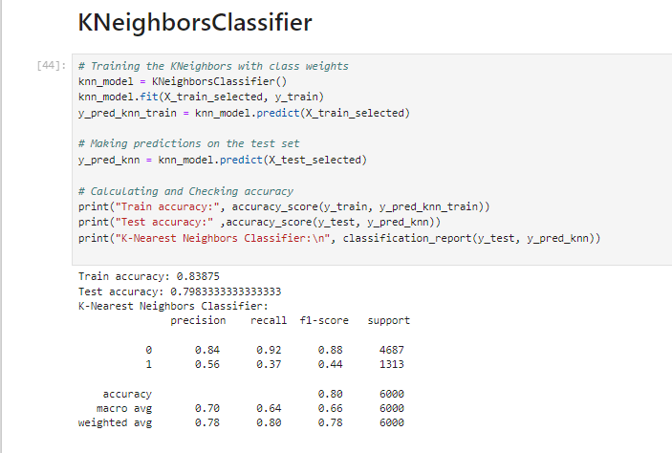
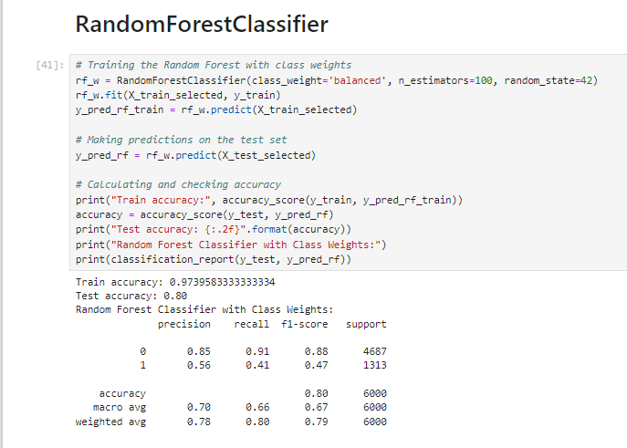
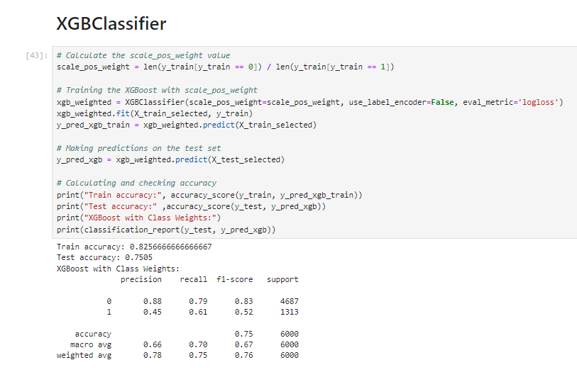

Slide 13
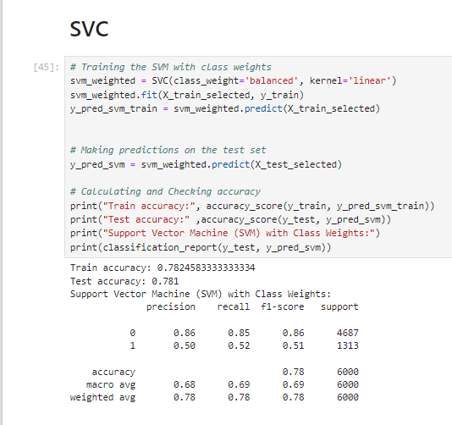
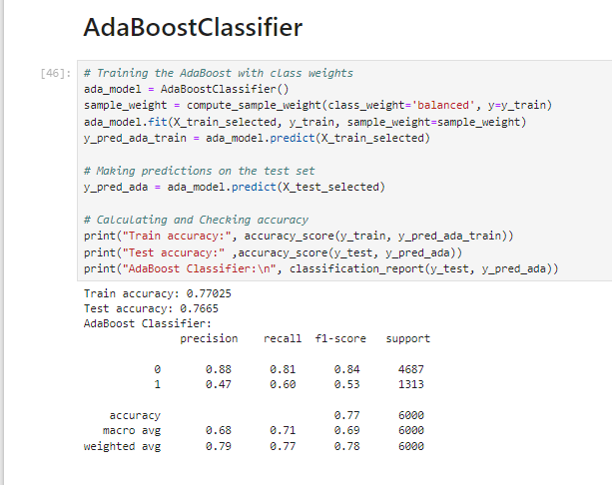
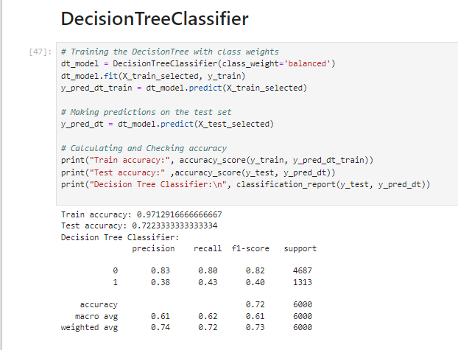

Slide 14
CONCLUSION
Analysis Importance:
The dataset and methodology would be required, including data cleaning steps, statistical analysis, and modeling approaches used to understand default behavior. Data analysis and predictive modeling play in understanding and mitigating the risks associated with credit card defaults.
Future Directions:
Future work could involve refining models,
exploring additional variables, and
considering external economic factors.

Slide 15
THANKS FOR WATCHING

